Slide 1


The Value of
Student Career Development
Administration 036
(740) 351-3027
careers@shawnee.edu

Slide 2

Why LinkedIn?
Over 433 million members
Allows you to connect to various professionals
Access to people, jobs, news, updates, and insights
It’s FREE!!!

Slide 3
How LinkedIn Can Help You
Establish your professional profile and control one of the top search results for your name
Build and maintain your professional network
Find and reconnect with colleagues and classmates
Learn about other companies, and get industry insights.
Find other professionals in the same industry using groups.
Tap into the knowledge of your network.
Discover new career opportunities by searching for jobs.

Slide 4
LinkedIn Statistics
More than 433 million members in 200 countries and territories
An average of two new members join LinkedIn every second
40% of LinkedIn users check LinkedIn every day
The average CEO has 930 connections
Over 39 million students and recent graduates on LinkedIn
People who list skills on their profile get 13 times more views
LinkedIn is available in 20 different languages

Slide 5
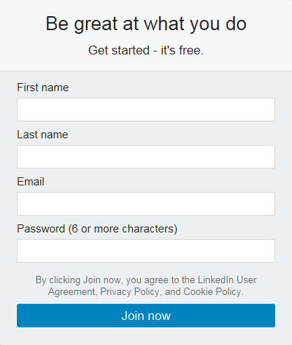
How to Create a Profile?
Go to LinkedIn at www.linkedin.com
Join now!

Slide 6
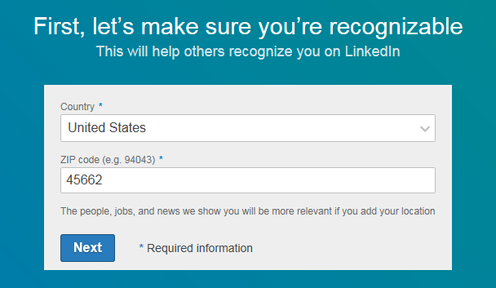
Creating a Profile
Add in your country and zip code

Slide 7
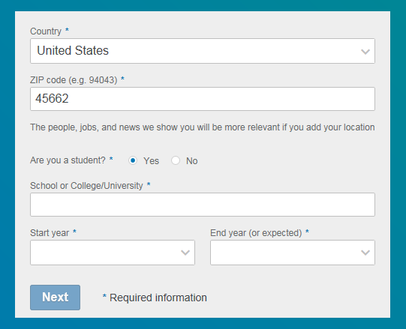
Creating a Profile
Add in your school along with start and end year (or expected)

Slide 8
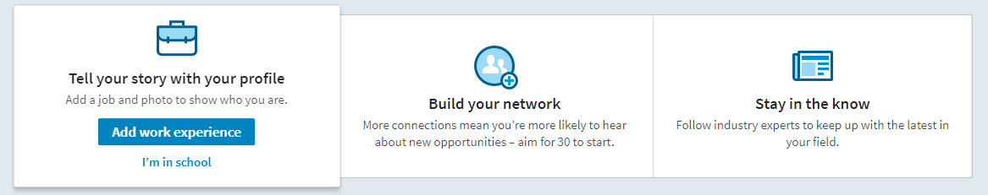
Creating a Profile
Why are you creating your profile?
Keeping in contact
To get a job
Staying up-to-date
Building your network

Slide 9
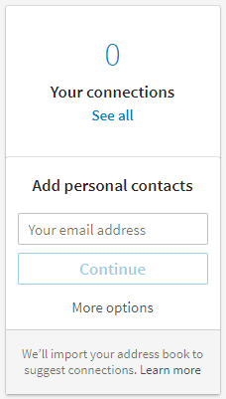
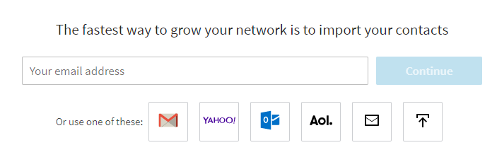
Creating a Profile
Verify your email address
Option to add and invite contacts

Slide 10
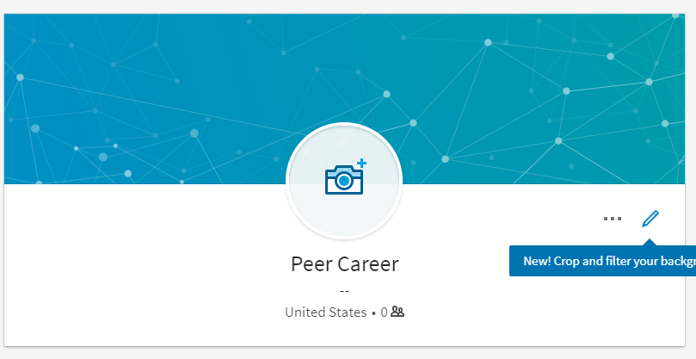


Personalize Your Profile
Tips for choosing a profile photo:
Choose a picture that looks like you
Make sure your face takes up at least 60% of the frame
Choose the right expression
Wear appropriate clothes
No selfies allowed!
Choose a background that isn’t distracting
Having a professional LinkedIn photo makes your profile 14 times more likely to be viewed!
Notes:
You don’t have to wear a suit and tie, but make sure your dress is appropriate

Slide 11
Build Your Profile Strength
Photo
Add professional profile
Experience
Keep work experience relevant
Skills
Show off your skills here!
Volunteering Experience
Great time to start volunteering
Organizations
Part of an organization on campus?
Honors & Awards
Show any recognition you have earned
Summary
Highlights your experience and interests

Slide 12
Build Your Profile Strength
Test Scores
Post any impressive test scores
Publications
Have any publications?
Interests
Share your professional and personal interests
Causes you care about
Passionate about something? Share it here!
Projects
Helps show skills, experience, and people you have worked with
Certifications
Include any relevant certification

Slide 13
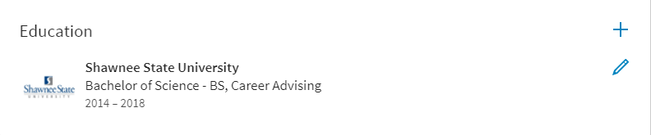
Education
What degree(s) do you have or are you working towards?
Field of study
GPA
Add all post-high school education

Slide 14
Things to Remember
Fill out the summary field with 5-6 of your biggest achievements
Add images or documents to your experience
Resume, portfolio, etc.
Fill out as much as possible
Keep work history relevant
Check into your profile frequently
Add connections

Slide 15

Get the App
It’s FREE
Easily check into your profile
For Apple & Android

Slide 16
Quiz
Complete this online quiz by clicking on the link & answering the questions
There will be weeks during the semester where we send emails about a drawing for having the quiz completed by a certain date
https://forms.office.com/Pages/ResponsePage.aspx?id=IFyHJnWyD0WMgACyQ421GztZCWXX7PRKk4oe8BUmKAJUMzlXVDEwQkZNNklENDJKRjhVRTY2SkUwTy4u

Slide 17
Questions? Contact Us!
Student Career Development
ADMIN 036
careers@shawnee.edu
740.351.3027

Slide 18
References
LinkedIn Help. (n.d.). Retrieved October 03, 2016, from
https://www.linkedin.com/help/linkedin/answer/
45/how-linkedin-can-help-you?lang=en
https://business.linkedin.com/talent-solutions/blog/2014/12/5-tips-for-picking-the-right-linkedin-profile-picture
https://www.linkedin.com/pulse/2016-linkedin-stats-you-should-know-updated-katy-elle-blake?published=t

